Slide 1
AP Statistics
Exam Review
Corey Andreasen
Updated by Jeff Borland
(Thanks to Paul L. Myers and Vicki Greenberg of Woodward Academy, Atlanta, GA for the structure of this review)

Slide 2
What Percentage of the Earth’s Surface is Water? They say its 70%
Variable of Interest:
Parameter of Interest:
Test:
Null Hypothesis:
Alternative Hypothesis:
Conditions:
Test Statistic:
Decision Rule:
Conclusion:
Sample Data 100 samples
Water | Land
67 | 33

Slide 3
Topic Outline
Topic | Exam Percentage
Exploring Data | 20%-30%
Sampling & Experimentation | 10%-15%
Anticipating Patterns | 20%-30%
Statistical Inference | 30%-40%

Slide 4
Exam Format
Questions | Percent of AP Grade | Time
40 Multiple Choice | 50% | 90 minutes (2.25 minutes/question)
6 Free-Response 5 Short Answer 1 Investigative Task | 50% | 90 minutes 12 minutes/question 30 minutes

Slide 5
Free Response Question Scoring
4 | Complete
3 | Substantial
2 | Developing
1 | Minimal
0

Slide 6
AP Exam Grades
5 | Extremely Well-Qualified
4 | Well-Qualified
3 | Qualified
2 | Possibly Qualified
1 | No Recommendation

Slide 7
I. Exploring Data
Describing patterns and departures from patterns (20%-30%)
Exploring analysis of data makes use of graphical and numerical techniques to study patterns and departures from patterns. Emphasis should be placed on interpreting information from graphical and numerical displays and summaries.

Slide 8
I. Exploring Data
Constructing and interpreting graphical displays of distributions of univariate data (dotplot, stemplot, histogram, cumulative frequency plot)
Center
Spread
Shape (Clusters and gaps)
Outliers and other unusual features

Slide 9
I. Exploring Data
Summarizing distributions of univariate data
Measuring center: median, mean
Measuring spread: range, interquartile range, standard deviation
Measuring position: quartiles, percentiles, standardized scores (z-scores)
Using boxplots
The effect of changing units on summary measures

Slide 10
I. Exploring Data
Comparing distributions of univariate data (dotplots, back-to-back stemplots, parallel boxplots)
Comparing center and spread: within group, between group variables
Comparing clusters and gaps
Comparing outliers and other unusual features
Comparing shapes

Slide 12
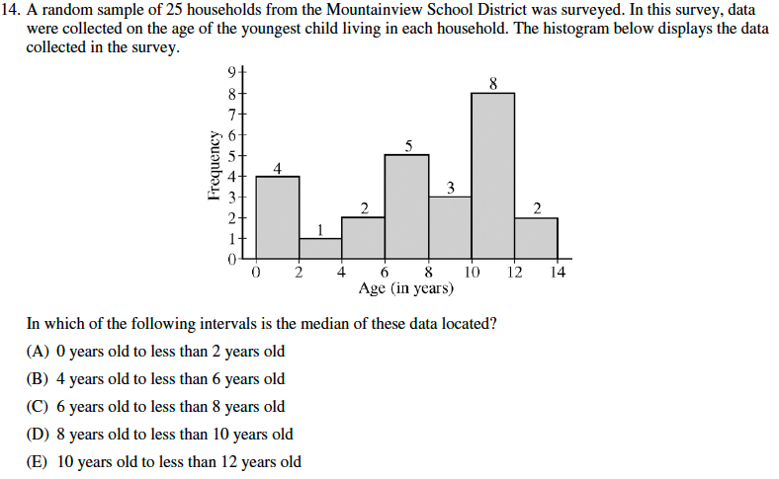

Slide 13
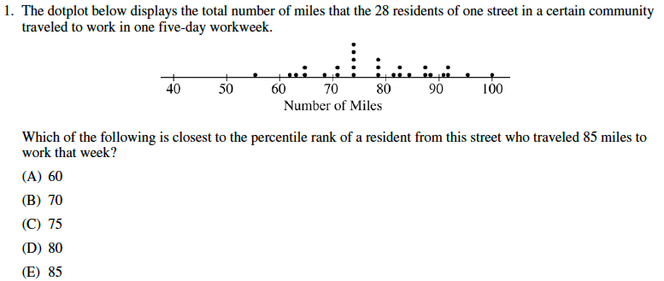

Slide 15
2006 FR#1 – The Catapults
Two parents have each built a toy catapult for use in a game at an elementary school fair. To play the game, the students will attempt to launch Ping-Pong balls from the catapults so that the balls land within a 5-centimeter band. A target line will be drawn through the middle of the band, as shown in the figure below. All points on the target line are equidistant from the launching location. If a ball lands within the shaded band, the student will win a prize.

Slide 16
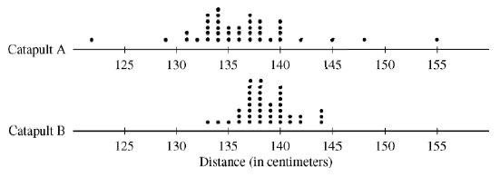
2006 FR#1 – The Catapults
The parents have constructed the two catapults according to slightly different plans. They want to test these catapults before building additional ones. Under identical conditions, the parents launch 40 Ping-Pong balls from each catapult and measure the distance that the ball travels before landing. Distances to the nearest centimeter are graphed in the dotplot below.

Slide 17
2006 FR#1 – The Catapults
Comment on any similarities and any differences in the two distributions of distances traveled by balls launched from catapult A and catapult B.
If the parents want to maximize the probability of having the Ping-Pong balls land within the band, which one of the catapults, A or B, would be better to use than the other? Justify your choice.
Using the catapult that you chose in part (b), how many centimeters from the target line should this catapult be placed? Explain why you chose this distance.

Slide 18
I. Exploring Data
Exploring 2 variable data
Analyzing patterns in scatterplots
Correlation and linearity
Least-squares regression line
Residuals plots, outliers, and influential points
Transformations to achieve linearity: logarithmic and power transformations?

Slide 20
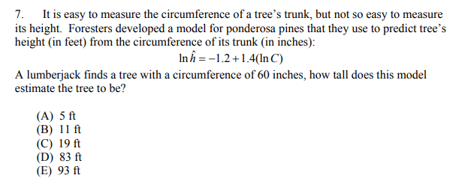

Slide 21
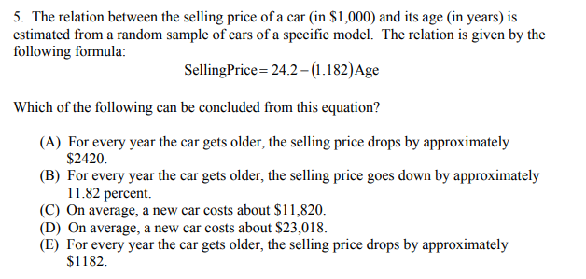

Slide 23
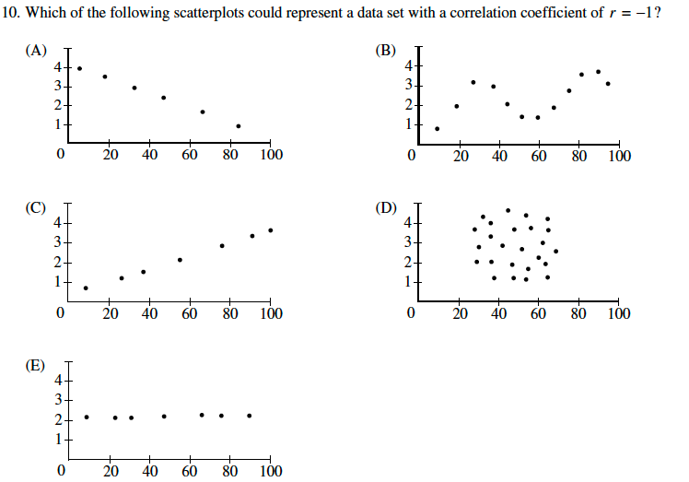

Slide 24
2006 FR Q#2 – Soapsuds
A manufacturer of dish detergent believes the height of soapsuds in the dishpan depends on the amount of detergent used. A study of the suds’ height for a new dish detergent was conducted. Seven pans of water were prepared. All pans were of the same size and type and contained the same amount of water. The temperature of the water was the same for each pan. An amount of dish detergent was assigned at random to each pan, and that amount of detergent was added to that pan. Then the water in the dishpan was agitated for a set of amount of time, and the height of the resulting suds were measured.

Slide 25
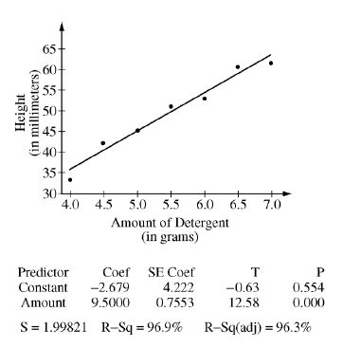
2006 FR Q#2 – Soapsuds
A plot of the data and the computer printout from fitting a least-squares regression line to the data are shown below.
Write the equation of the fitted regression line. Define any variables used in this equation.
Note that s = 1.99821 in the computer output. Interpret this value in the context of the study.
Identify and interpret the standard error of the slope.

Slide 26
I. Exploring Data
Exploring categorical data
Frequency tables and bar charts
Marginal and joint frequencies for two-way tables
Conditional relative frequencies and association
Comparing distributions using bar charts

Slide 27
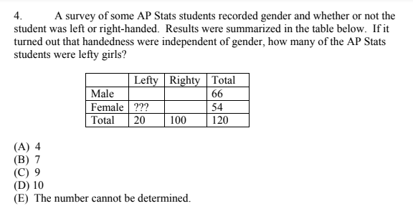

Slide 29
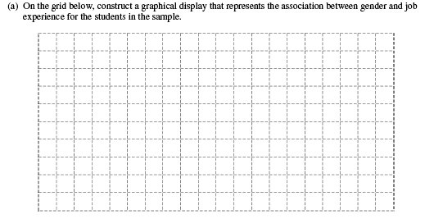

Slide 31
This is an example of a Free Response question in which the first parts involve Exploratory Data Analysis and later parts involve inference.

Slide 32
II. Sampling and Experimentation
Planning and conducting a study (10%-15%)
Data must be collected according to a well-developed plan if valid information on a conjecture is to be obtained. This includes clarifying the question and deciding upon a method of data collection and analysis.

Slide 33
II. Sampling and Experimentation
Overview of methods of data collection
Census
Sample survey
Experiment

Slide 34
II. Sampling and Experimentation
Planning and conducting surveys
Characteristics of a well-designed and well-conducted survey
Populations, samples, and random selection
Sources of bias in sampling and surveys
Sampling methods, including simple random sampling, stratified random sampling, and cluster sampling

Slide 35
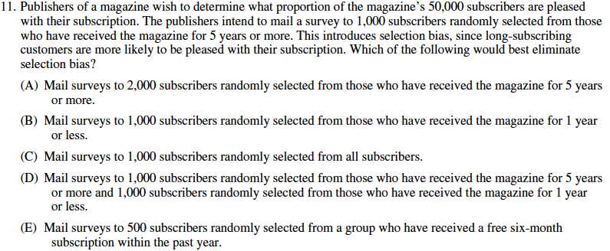

Slide 38
II. Sampling and Experimentation
Planning and conducting experiments
Characteristics of a well-designed and well-conducted experiment
Treatments, control groups, experimental units, random assignments, and replication
Sources of bias and confounding, including placebo effect and blinding
Randomized block design, including matched pairs design

Slide 39
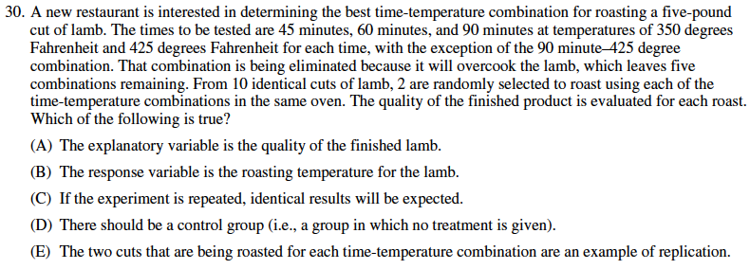

Slide 40
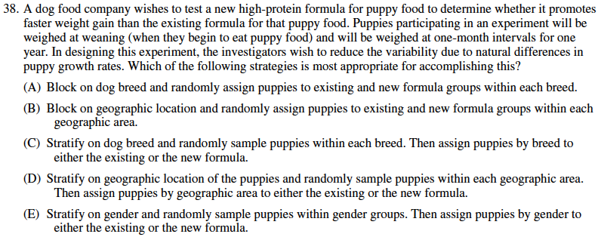

Slide 41
Does Type Font Affect Quiz Grades?
Population of Interest
AP Statistics Students
Subjects
AP Statistics Review Participants
Treatments
Font I and Font II

Slide 42
II. Sampling and Experimentation
Generalizability of results and types of conclusions that can be drawn from observational studies, experiments, and surveys

Slide 44
III. Anticipating Patterns
Exploring random phenomena using probability and simulation (20%-30%)
Probability is the tool used for anticipating what the distribution of data should look like under a given model.

Slide 45
III. Anticipating Patterns
Probability
Interpreting probability, including long-run relative frequency interpretation
“Law of Large Numbers” concept
Addition rule, multiplication rule, conditional probability, and independence
Discrete random variables and their probability distributions, including binomial and geometric
Simulation of random behavior and probability distributions
Mean (expected value) and standard deviation of a random variable and linear transformation of a random variable

Slide 46
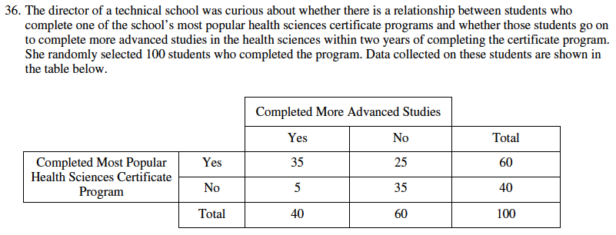

Slide 49
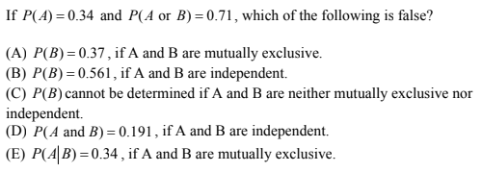

Slide 50
Probability – Sample Multiple Choice
All bags entering a research facility are screened. Ninety-seven percent of the bags that contain forbidden material trigger an alarm. Fifteen percent of the bags that do not contain forbidden material also trigger the alarm. If 1 out of every 1,000 bags entering the building contains forbidden material, what is the probability that a bag that triggers the alarm will actually contain forbidden material?

Slide 51
Organize the Problem
Label the Events
F – Bag Contains Forbidden Material
A – Bag Triggers an Alarm
Determine the Given Probabilities
P(A|F) = 0.97
P(A|F^{C}) = 0.15
P(F) = 0.001
Determine the Question
P(F|A) ?

Slide 52
Set up a Tree Diagram
A
0.97
F
0.03
0.001
A^{C}
Conditional
Probabilities
Non-Conditional Probabilities
A
0.999
0.15
F^{C}
0.85
A^{C}

Slide 53
Calculate the Probability
P(F|A) = P(F and A) / P(A)
P(A) = P(F and A) or P(F^{C} and A)
= .001(.97) + .999(.15) = .15082
P(F and A) = .001(.97) = .00097
P(F|A) = .00097/.15082 = 0.006

Slide 54
III. Anticipating Patterns
Combining independent random variables
Notion of independence versus dependence
Mean and standard deviation for sums and differences of independent random variables

Slide 57
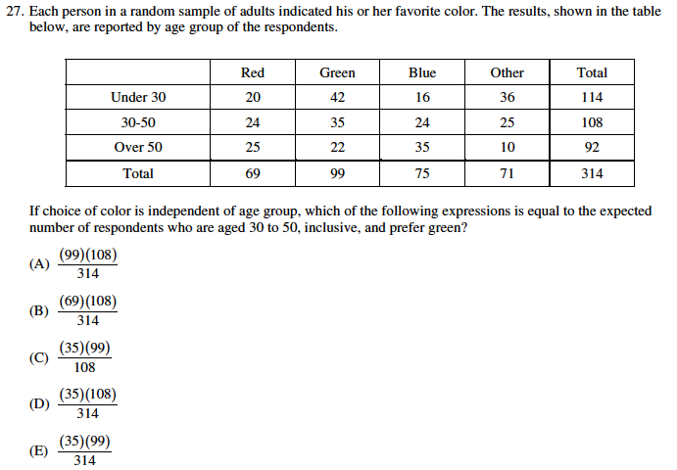

Slide 59
III. Anticipating Patterns
The normal distribution
Properties of the normal distribution
Using calc for the normal distribution

Slide 62
2002 AP STATISTICS FR#3 - The Runners
There are 4 runners on the New High School team. The team is planning to participate in a race in which each runner runs a mile. The team time is the sum of the individual times for the 4 runners. Assume that the individual times of the 4 runners are all independent of each other. The individual times, in minutes, of the runners in similar races are approximately normally distributed with the following means and standard deviations.
(a) Runner 3 thinks that he can run a mile in less than 4.2 minutes in the next race. Is this likely to happen? Explain.
(b) The distribution of possible team times is approximately normal. What are the mean and standard deviation of this distribution?
(c) Suppose the teams best time to date is 18.4 minutes. What is the probability that the team will beat its own best time in the next race?
Runner | Mean | SD
1 | 4.9 | 0.15
2 | 4.7 | 0.16
3 | 4.5 | 0.14
4 | 4.8 | 0.15

Slide 63
IV. Statistical Inference
Estimating population parameters and testing hypotheses (30%-40%)
Statistical inference guides the selection of appropriate models.

Slide 64
IV. Statistical Inference
See Notes - here

Slide 65
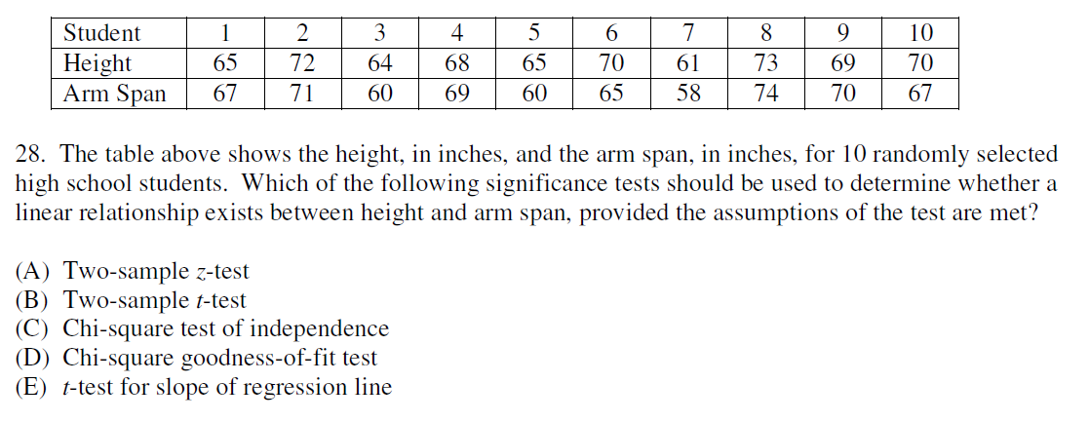

Slide 66
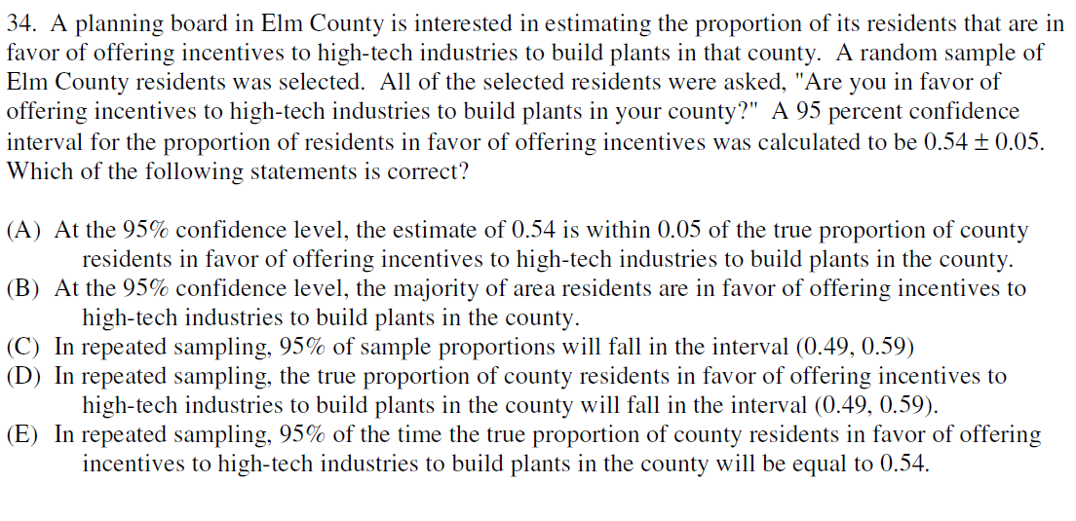

Slide 69
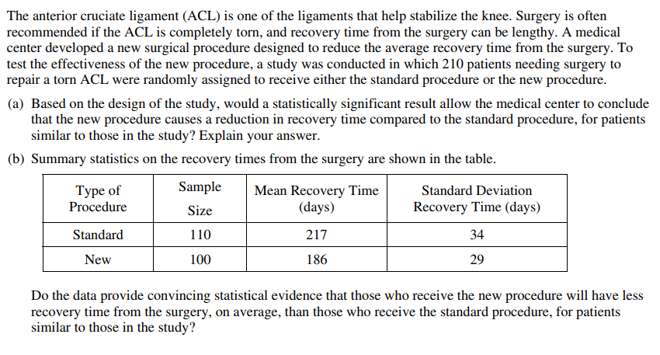

Slide 70
Simple Things Students Can Do To Improve Their AP Exam Scores
1. Read the problem carefully, and make sure that you understand the question that is asked. Then answer the question(s)!
Suggestion: Circle or highlight key words and phrases. That will help you focus on exactly what the question is asking.
Suggestion: When you finish writing your answer, re-read the question to make sure you haven’t forgotten something important.
2. Write your answers completely but concisely. Don’t feel like you need to fill up the white space provided for your answer. Nail it and move on.
Suggestion: Long, rambling paragraphs suggest that the test-taker is using a shotgun approach to cover up a gap in knowledge.
3. Don’t provide parallel solutions. If multiple solutions are provided, the worst or most egregious solution will be the one that is graded.
Suggestion: If you see two paths, pick the one that you think is most likely to be correct, and discard the other.
4. A computation or calculator routine will rarely provide a complete response. Even if your calculations are correct, weak communication can cost you points. Be able to write simple sentences that convey understanding.
Suggestion: Practice writing narratives for homework problems, and have them critiqued by your teacher or a fellow student.
5. Beware careless use of language.
Suggestion: Distinguish between sample and population; data and model; lurking variable and confounding variable; r and r2; etc. Know what technical terms mean, and use these terms correctly.

Slide 71
Simple Things Students Can Do To Improve Their AP Exam Scores
6. Understand strengths and weaknesses of different experimental designs.
Suggestion: Study examples of completely randomized design, paired design, matched pairs design, and block designs.
7. Remember that a simulation can always be used to answer a probability question.
Suggestion: Practice setting up and running simulations on your TI-83/84/89.
8. Recognize an inference setting.
Suggestion: Understand that problem language such as, “Is there evidence to show that … ” means that you are expected to perform statistical inference. On the other hand, in the absence of such language, inference may not be appropriate.
9. Know the steps for performing inference.
hypotheses
assumptions or conditions
identify test (confidence interval) and calculate correctly
conclusions in context
Suggestion: Learn the different forms for hypotheses, memorize conditions/assumptions for various inference procedures, and practice solving inference problems.
10. Be able to interpret generic computer output.
Suggestion: Practice reconstructing the least-squares regression line equation from a regression analysis printout. Identify and interpret the other numbers.

